Slide 1
Global E-Business and Collaboration
Unit -2

Slide 2
Business Processes
"Refers to how work is organized, coordinated, and focused to create valuable products or services.“
Processes are made up of activities
"Business processes consist of various activities required to produce a product or service.“
Supportive Elements
"Activities are supported by flows of material, information, and knowledge among participants.“
Business as a Collection of Processes
"Each business can be viewed as a collection of interlinked business processes, some being part of larger processes."

Slide 3
Business Processes
The performance of business process depends on how well its business processes are designed and coordinated.
(Good Design = Good Performance)
A company’s business process can be a source of competitive strength if they enable the company to innovate or to execute better than its rivals.
Business processes can be liabilities if they are based on outdated ways of working that impede organizational responsiveness and efficiency.
(Bad Processes = Weakness)
Many business processes are tied to a functional area. For example, the sales and marketing function is responsible for identifying customers, and the human resource function is responsible for hiring employees.
(Processes Are Often Functional)

Slide 4
Business Process and Information System (relationship)
Business depend on Information
"To operate effectively, businesses handle various information about suppliers, customers, employees, invoices, payments, products, and services.“
Organization is key to efficiency
"Organizing work activities that utilize this information is essential for efficient operation and enhanced overall performance. (simply having data isn’t enough)“
Role of Information Systems (IS are tools for success)
"Information systems enable firms to manage all information effectively, make informed decisions, and improve execution in business processes."

Slide 5
Various Business Processes of Organizations
Manufacturing and Production
Assembling the product
Checking for quality
Producing bills of materials
Sales and Marketing
Identifying customers
Making customers aware of the product
Selling the product
Finance and Accounting
Paying creditors
Creating financial statements
Managing cash accounts
Human Resources
Hiring employees
Evaluating employees’ job performance
Evaluating employees’ benefit plans

Slide 6
Cross-Functional Business Processes
"Business processes span multiple functional areas, requiring seamless coordination across departments.“
Example: Fulfilling a Customer Order
Sales Department: Receives the sales order.
Accounting Department: Verifies customer credit or requests immediate payment before shipping.
Production Department: Pulls the product from inventory or manufactures it if needed.
Shipping: Ships the product to the customer.

Slide 7
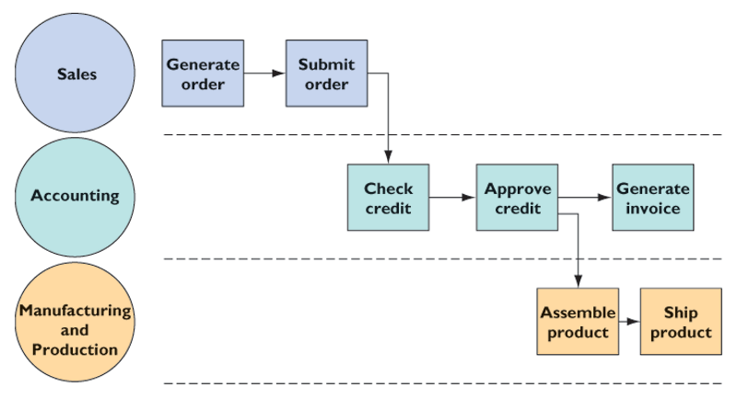
Example : Order Fulfillment process

Slide 8
Major types of information systems
Transaction processing System (TPS)
Management Information System (MIS)
Decision-Support System (DSS)
Executive –Support System (ESS)
Office Automation System
Expert System

Slide 9
Four major types of information systems
Transaction Processing Systems (TPS)
Basic business systems that serve the organization’s operational level (routine, day-to-day transactions)
Input: Transactions, events (sales, payments)
Processing: Sorting, listing, merging, updating
Output: Detailed reports, lists, summaries
Users: Operations personnel, supervisors

Slide 10
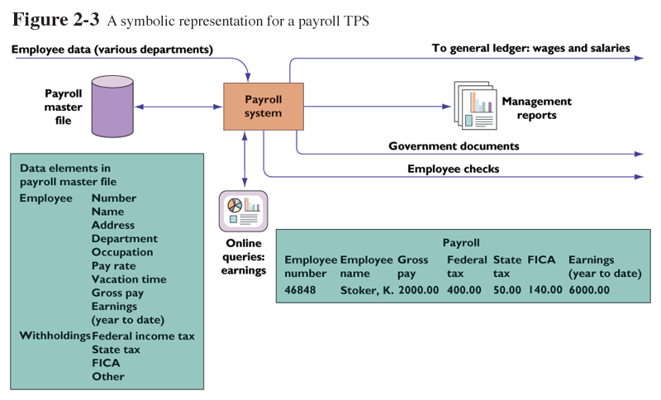
A symbolic representation for a payroll TPS

Slide 11
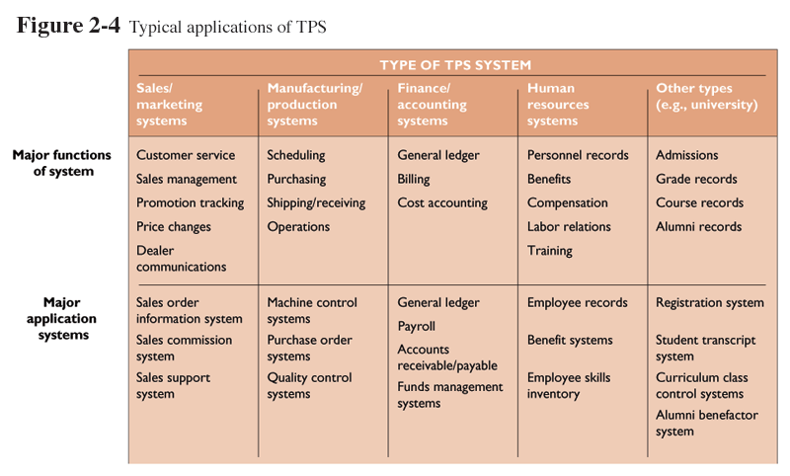
Typical applications of TPS

Slide 12
Four major types of information systems
Management Information Systems (MIS)
Serve management level; provide reports and access to company data
Input: Summary transaction data, high-volume data, simple models
Processing: Routine reports, simple models, low-level analysis
Output: Summary and exception reports
Users: Middle managers

Slide 13
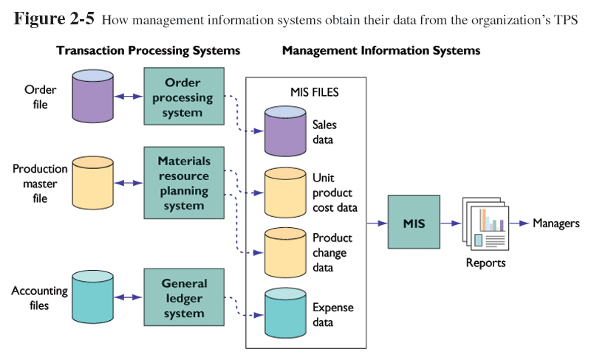
How management information systems obtain their data from the organization’s TPS

Slide 14
Four major types of information systems
Decision-Support Systems (DSS)
Serve management level with data analysis for making decisions
Input: Low-volume data or massive databases, analytic models, and data analysis tools
Processing: Interactive, simulations, analysis
Output: Special reports, decision analyses, responses to queries
Users: Professionals, staff managers

Slide 15
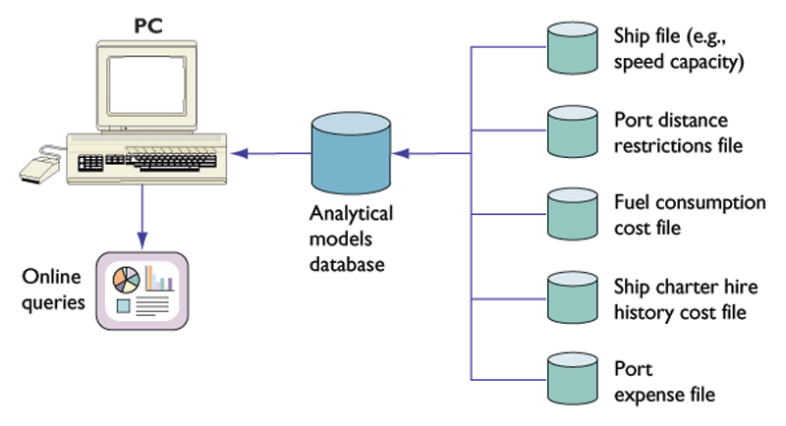
Voyage-estimating decision-support system

Slide 16
Four major types of information systems
Executive Support Systems (ESS)
Provide communications and computing environment that serves the organization’s strategic level
Input: External and internal aggregate data
Processing: Graphics, simulations, interactive
Output: Projections, responses to queries
Users: Senior Managers

Slide 17
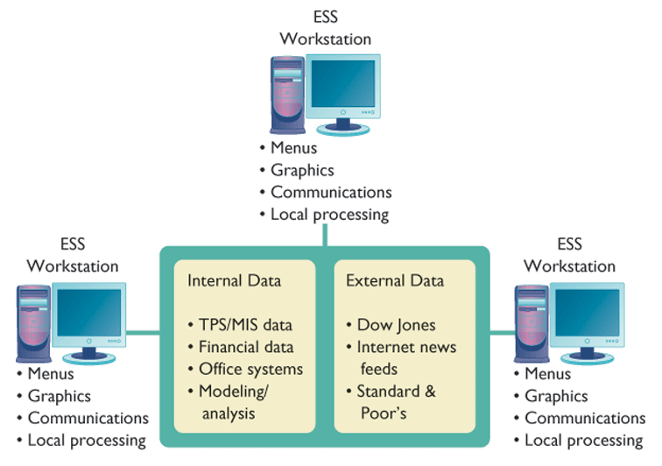
Model of a typical executive support system

Slide 18
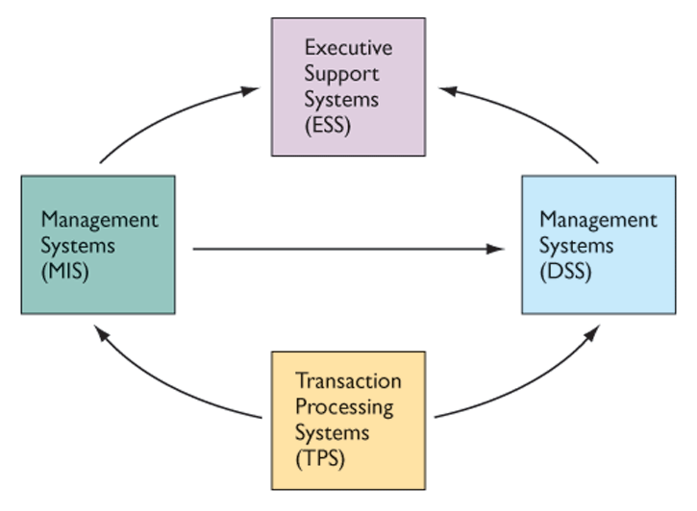
Interrelationships among systems

Slide 19
Additional Systems
Office Automation System: "Facilitates everyday office functions, including document management, scheduling, and communication."
Expert System: "Simulates human expertise to assist in complex decision-making or problem-solving."

Slide 20
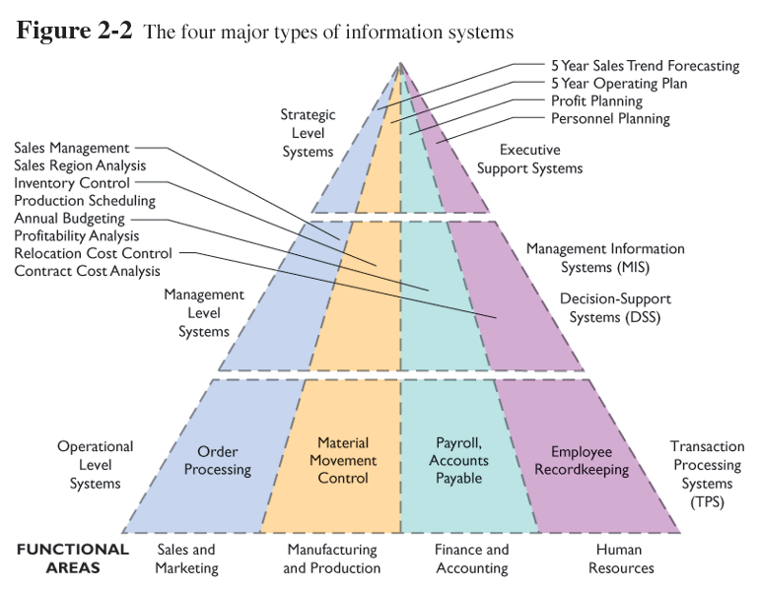
The four major types of information systems

Slide 21
What are Enterprise Applications?
Systems that span functional areas and levels of management
Focus on executing business processes across the organization
Aim to streamline and enhance business operations
Advantages of Enterprise Applications:
Improved flexibility and productivity
Enhanced resource management
Better customer service integration

Slide 22
Systems for Linking the Enterprise
Enterprise Systems
Integrate key internal business processes
Improve decision-making and coordination within the firm
Supply Chain Management Systems
Manage relationships with suppliersOptimize planning, sourcing, manufacturing, and delivery

Slide 23
Systems for Linking the Enterprise
Customer Relationship Management (CRM)
Coordinate customer-related business processes
Enhance customer satisfaction and retention
Knowledge Management Systems (KMS)
Facilitate creation, sharing, and distribution of knowledge
Support informed decision-making across the firm

Slide 24
Systems for Linking the Enterprise
Key Challenges in Enterprise Coordination
Lack of proper coordination and integration in enterprises
Difficulty in synchronizing diverse systems
Impact: Reduced efficiency and challenges in decision-making

Slide 25
Collaboration in Organizations
What is Collaboration?
Working with others to achieve shared, explicit goals
Focuses on task or mission accomplishment
Takes place within businesses or between businesses
Collaboration can be short-lived or long-term depending on task and relationships

Slide 26
Systems for Collaboration and Teamwork
Importance of Collaboration in Organizations
Aligning stakeholders toward common goals
Coordinating plans and actions to drive success
Fostering teamwork and effective communication

Slide 27
Types of Collaboration
One-to-One Collaboration: Individual interactions focused on specific tasks
Many-to-Many Collaboration: Group or team collaboration with multiple participants
Informal vs. Formal Collaboration
  Informal Collaboration: Unofficial groups that are not part of the organizational structure
  Formal Collaboration: Organized teams within the firm with clear missions and objectives

Slide 28
Importance of Collaboration and Teamwork
Changing Nature of Work
From factory manufacturing to highly interactive, coordinated tasks
Increased need for collaboration in service/product development
Growth of Professional Work
"Interaction" jobs in the service sector demand close coordination
Professional roles require education and the sharing of knowledge
Changing Organization of the Firm
Transition from hierarchical management to team-based work structures
Teams are expected to develop their own methods for task completion

Slide 29
Importance of Collaboration and Teamwork
Changing Scope of the Firm
Work now spans multiple locations, countries, and continents
Need for global coordination across various departments (design, production, marketing)
Emphasis on Innovation
Innovation is often the result of team collaboration (e.g., Bill Gates, Steve Jobs)
Successful innovators build strong collaborative teams to support ideas
Changing Culture of Work and Business
Diverse teams often outperform individuals in problem-solving and innovation
Concepts like "crowdsourcing" and "wisdom of crowds" support the value of teamwork

Slide 30
Conclusion
Changing Nature of Work: Greater need for coordination and interaction in modern work
Growth of Professional Work: Jobs requiring education and information sharing
Changing Organization of the Firm: Shift from hierarchical management to collaborative groups and teams
Changing Scope of the Firm: Global presence demands cross-border collaboration
Emphasis on Innovation: Teams foster creativity and innovation (e.g., Bill Gates, Steve Jobs)
Changing Culture of Work: Diverse teams produce better outcomes, faster

Slide 31
Business benefits of collaboration and Teamwork
Productivity
Working together allows people to complete complex tasks faster than working individually
Teams can handle more complex problems with collective expertise
Quality
Collaborative teams can quickly communicate and address errors, reducing delays
Improved accuracy and fewer errors due to constant feedback loops
Reduces buffers and time delays in production processes
Innovation
Collaborative teams generate more innovative ideas than isolated workers
New solutions for production, service, and administration emerge faster

Slide 32
Business benefits of collaboration and Teamwork
Customer Service
Teams solve customer complaints and issues more effectively
Collaboration leads to quicker response times and more accurate solutions
Financial Performance
Collaboration results in improved sales growth and profitability
Teams that work well together lead to better business outcomes, including financial success

Slide 33
Conclusion
Collaboration boosts productivity, quality, innovation, customer service, and financial performance
Businesses that foster collaboration are more likely to succeed in a competitive

Slide 34
Tools and Technology for Collaboration and Teamwork
Collaborative culture needs the right information systems and tools
Hundreds of tools are designed to enhance collaboration across teams, employees, customers, and managers
Key tools include email, instant messaging, social networking, wikis, and virtual worlds

Slide 35
E-mail and Instant Messaging
Widely adopted by organizations for communication and collaboration
Available on computers, cell phones, and wireless devices
Instant messaging allows real-time conversations with multiple participants
Features for file sharing and message transmission

Slide 36
Social Networking
Social networking platforms (LinkedIn, MySpace, Facebook) help people share ideas and interact
Quickly becoming corporate tools for idea sharing and collaboration
Useful for interaction-based jobs and fostering collaboration within organizations

Slide 37
Wikis
Web platforms that allow users to easily contribute and edit content without technical skills
Wikipedia is a prime example of a successful collaborative wiki
Ideal for storing and sharing company knowledge, documents, and insights

Slide 38
Virtual Worlds
Online 3D environments with avatars representing real people (e.g., Second Life)
Companies like IBM and INSEAD use virtual worlds for meetings and training
Facilitates interaction, idea exchange, and virtual collaboration across locations

Slide 39
Internet-Based Collaboration Environments
Software suites offering multi-function platforms for teams working remotely
Tools for collaboration across multiple locations and diverse teams
Includes features like shared documents, communication tools, and task management

Slide 40
Virtual Meeting Systems
Videoconferencing and Web conferencing technologies for meetings and collaborations
Tele-presence technology creates the illusion of being in the same physical space
Reduces travel expenses and facilitates global teamwork

Slide 41
Conclusion
Tools like email, instant messaging, social networks, and virtual platforms are essential for modern collaboration
Technology bridges physical gaps and helps teams work more efficiently across locations
Implementing the right tools can significantly improve business performance and innovation

Slide 42
The Information System Functions
Why Information Systems Are Crucial?
Essential for Operations:
  Businesses depend on IT systems for daily functions.
  Supports decision-making and strategic initiatives.
Diverse System Types:
  Operational systems, management systems, and decision-support systems.
Key Question:
  Who ensures these systems operate seamlessly and stay updated?

Slide 43
The Information System Functions
Role of the Information Systems Department
Organizational Backbone for IT Services:
  Found in medium to large organizations.
  Formalized unit dedicated to IT management.
Primary Responsibilities:
  Maintain hardware, software, data storage, and networks.
  Ensure reliability and security of IT infrastructure.

Slide 44
Core Roles in the IS Department
Programmers:
Write and maintain software instructions.
Develop custom applications tailored to business needs.
Systems Analysts:
Serve as a bridge between IT and business teams.
Analyze business problems and translate them into IT requirements.
Information Systems Managers:
Lead teams of specialists (programmers, analysts, etc.).
Oversee project execution and long-term IT strategies.

Slide 45
Specialized Leadership Roles in IS
Chief Information Officer (CIO):
Oversees IT strategy and implementation.
Combines technology expertise with business leadership.
Chief Security Officer (CSO):
Responsible for IT and information security.
Educates staff on security measures and monitors threats.
Chief Privacy Officer (CPO):
Ensures compliance with data privacy laws.
Develops policies to safeguard personal data.
Chief Knowledge Officer (CKO):
Develops knowledge management programs.
Enhances use of organizational knowledge.

Slide 46
Collaboration Beyond the IS Department
End Users:
  Representatives from various departments outside IT.
  Involved in system design and application development.
  Provide insights to ensure systems align with business goals.
External Specialists:
  Consultants, vendors, and software providers play crucial roles.

Slide 47
Challenges in Managing Information Systems
Rapid Technological Changes: Keeping systems up to date with emerging tech trends.
Security Risks: Protecting sensitive data against breaches.
Compliance Issues: Adhering to evolving regulations on privacy and data protection.
Cross-Department Collaboration: Balancing IT efficiency with business requirements.

